Slide 1
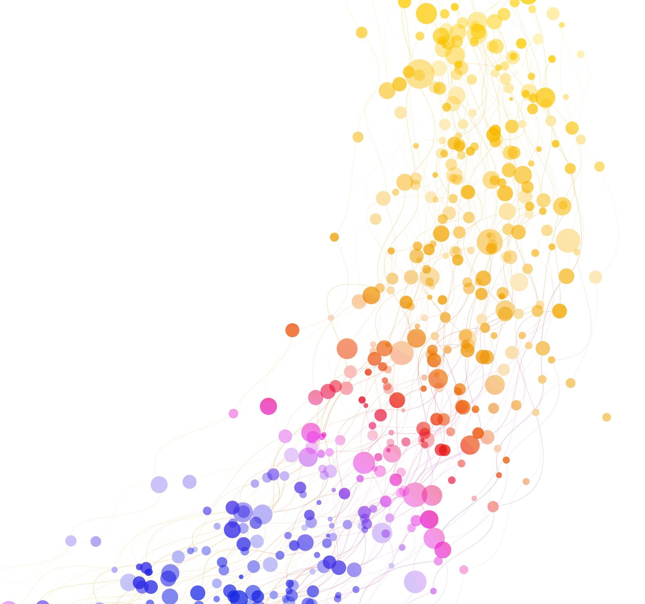
Benchmarking Modular Genetic Programming on Deep Memory Tasks
Mihyar Al Masalma

Slide 2
Road Map
What are we trying to achieve?
Tools and background.
Results
What’s next?
Q&A

Slide 3
What are you doing?
Different Instruction sets.
Different Noise.
Different task setup.

Slide 4
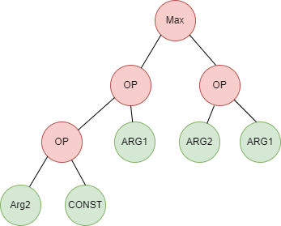
canonical GP?

Slide 5
Don’t know the whole story
What are partially observed tasks?
Why we care about it?
Where can we see it?
Notes:
Three approaches to tasks in ML (supervised, unsupervised and Reinforced Learning)
reinforcement learning, represents a decision making problem in which the learning agent has to maximize the cumulative rewards over a (possibly infinite) sequence of state inputs
RL two types (complete and partial – needs to build internal mental model)

Slide 6
I need to remember
Why memory is important?
Internal vs external
Notes:
Canonical GP is reactive to overcome that and work with partially observed tasks we need memory.

Slide 7
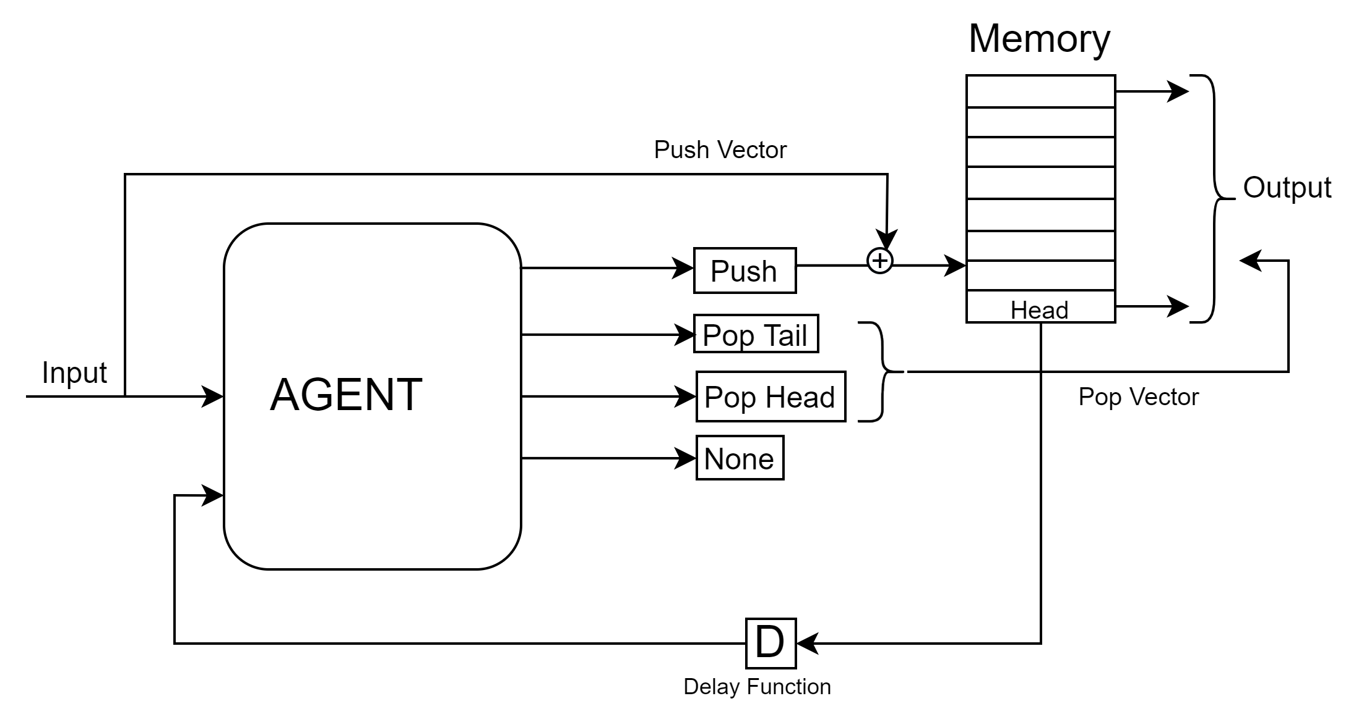
External memory interface

Slide 8
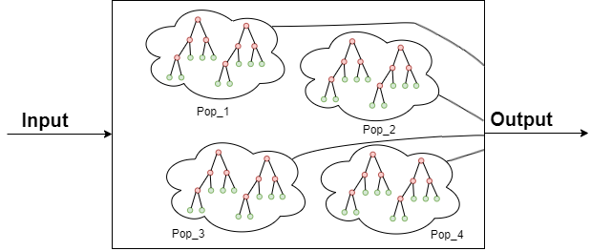
One output means One population
Limitation of canonical GP.
Work around and teams forming.

Slide 9
Deep memory tasks
Sequence Classification
Sequence Recall
Copy Task

Slide 10
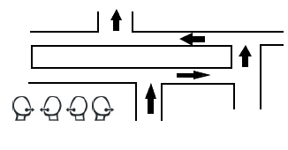

Sequence Recall

Slide 11
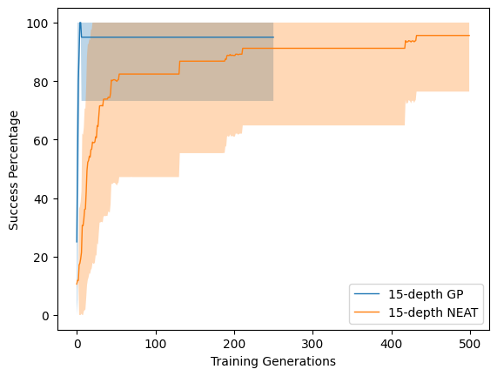
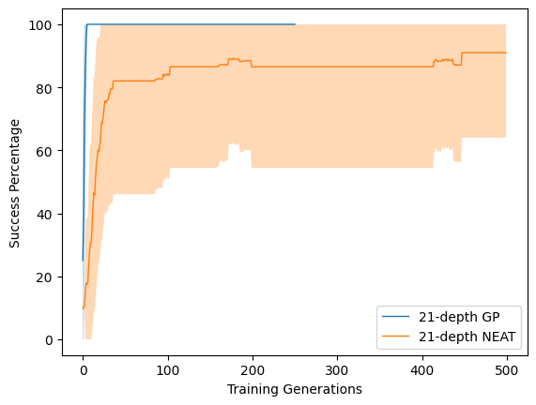
Genetic programming vs neural network

Slide 12
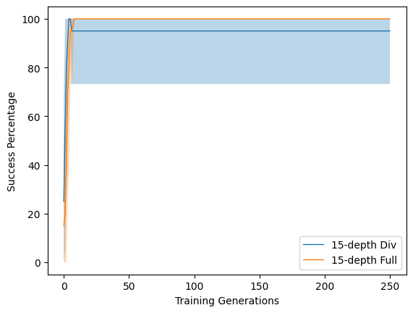
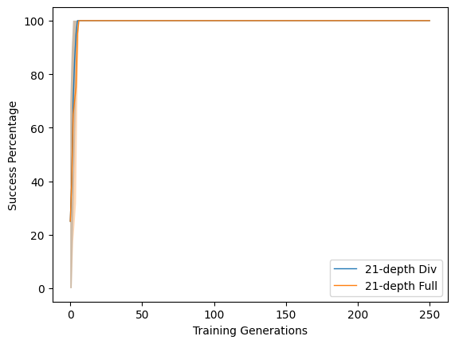
Division vs full instruction set

Slide 13
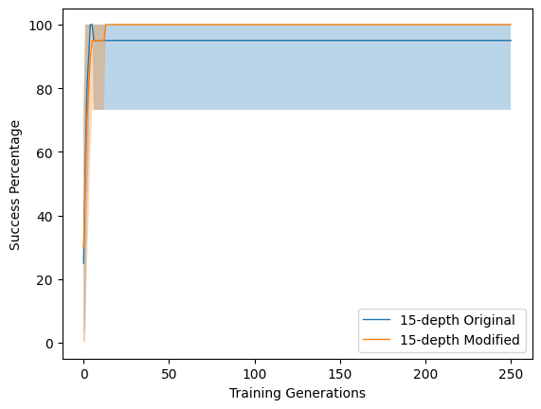
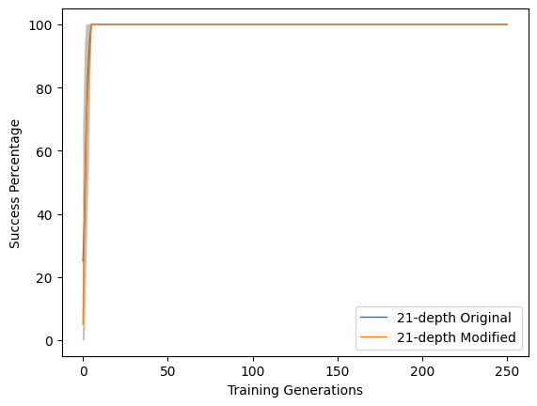
Original vs modified setup
Notes:
TODO: Add how task setup is different

Slide 14
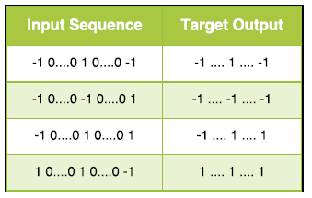
Sequence classification

Slide 15
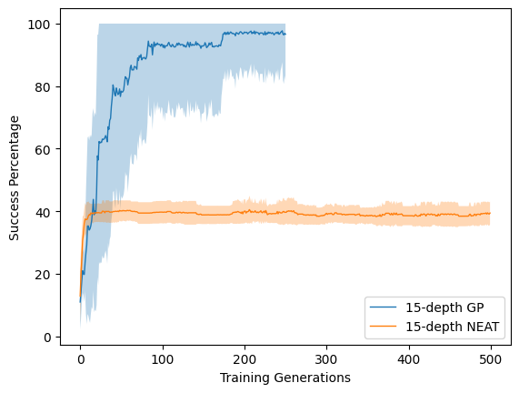
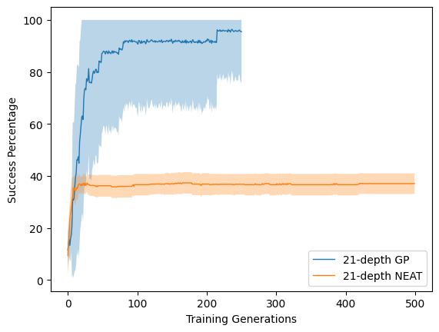
Genetic Programing vs Neural Network

Slide 16
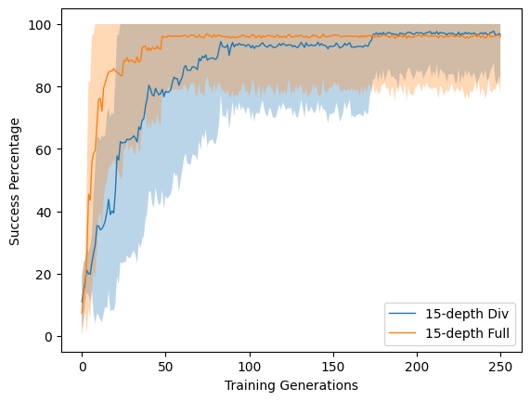
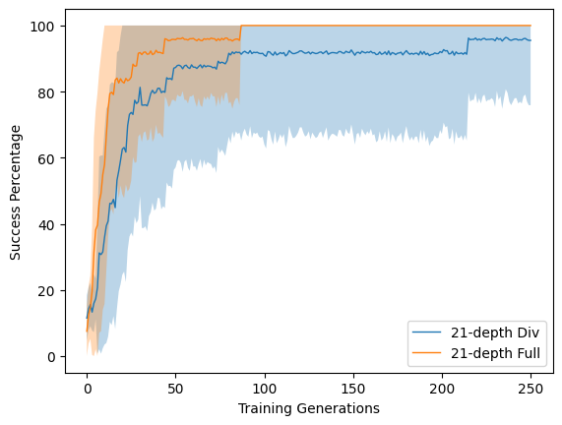
Division vs full instruction set
Notes:
Multiplication instruction set didn’t perform well, results were non-comparable.

Slide 17
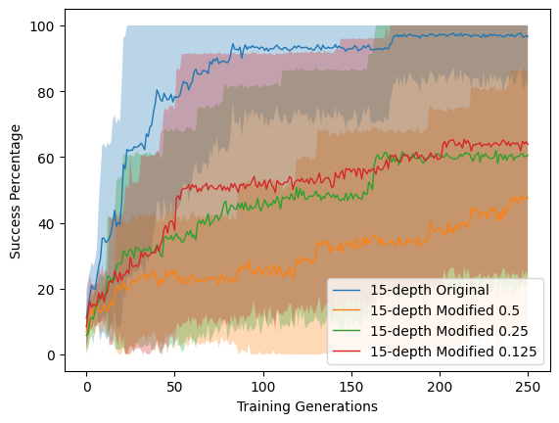
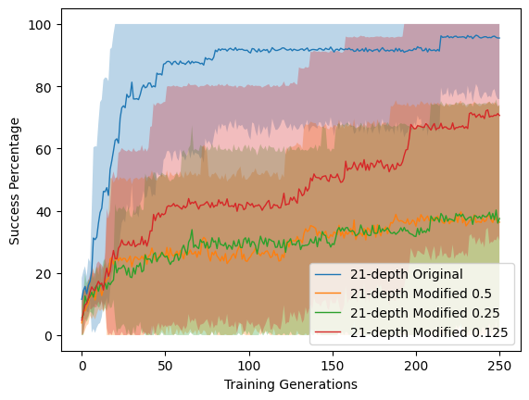
Original vs modified setup
Notes:
TODO: add the new task setup and noise

Slide 18
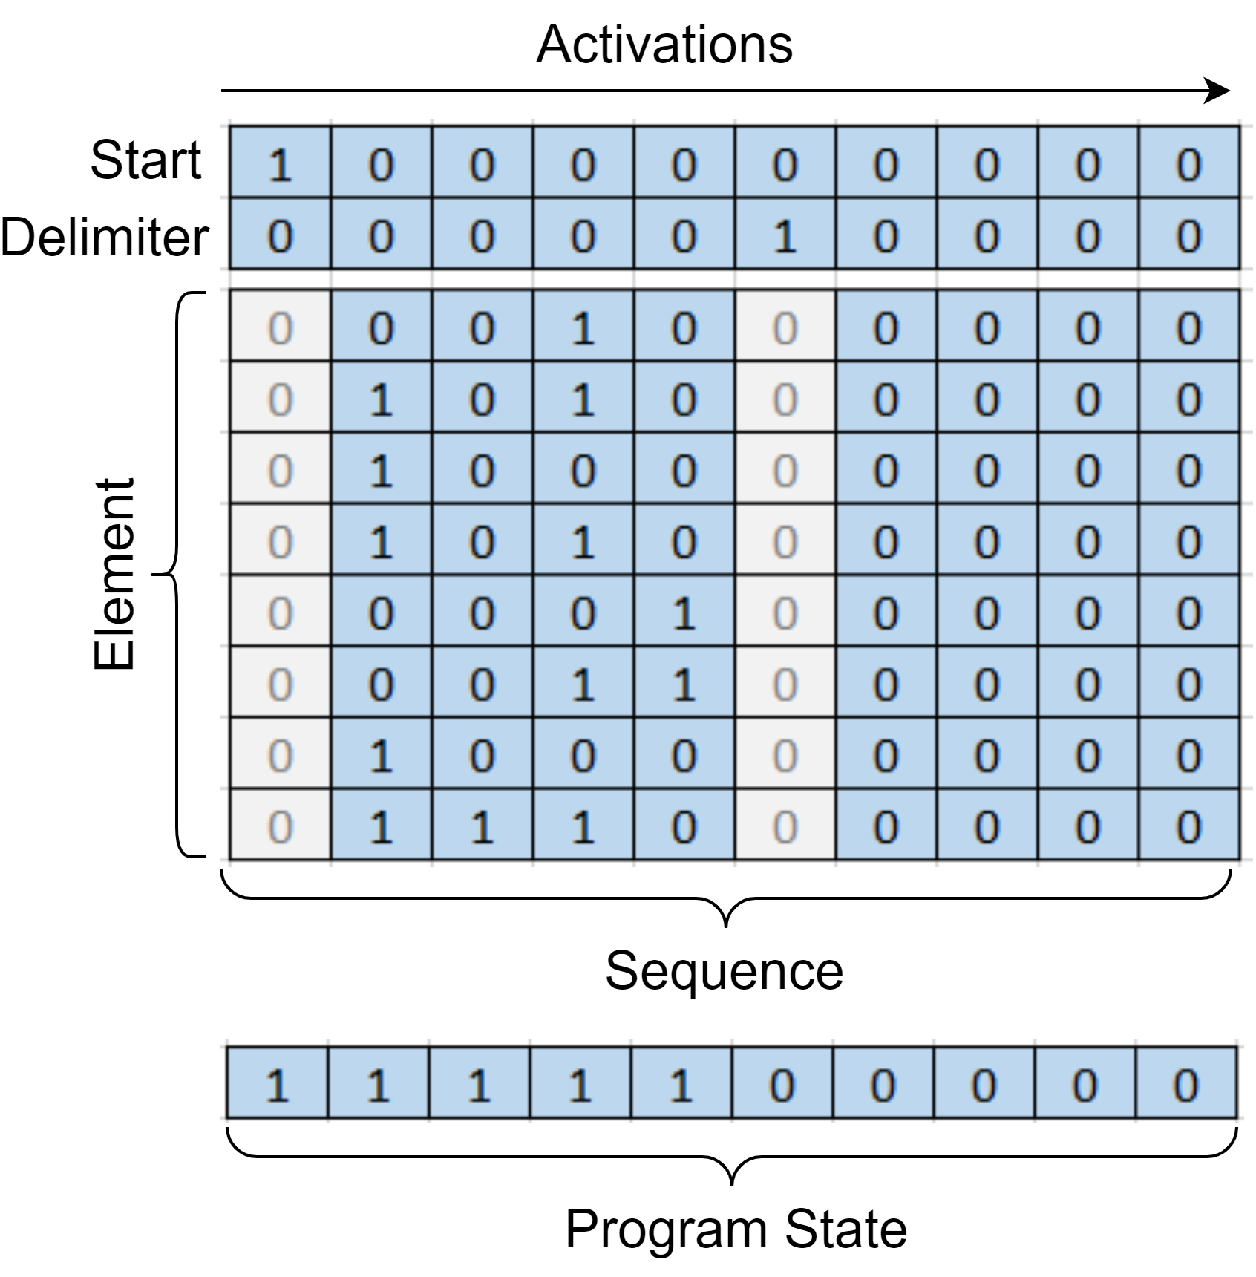
Copy Task setup

Slide 19
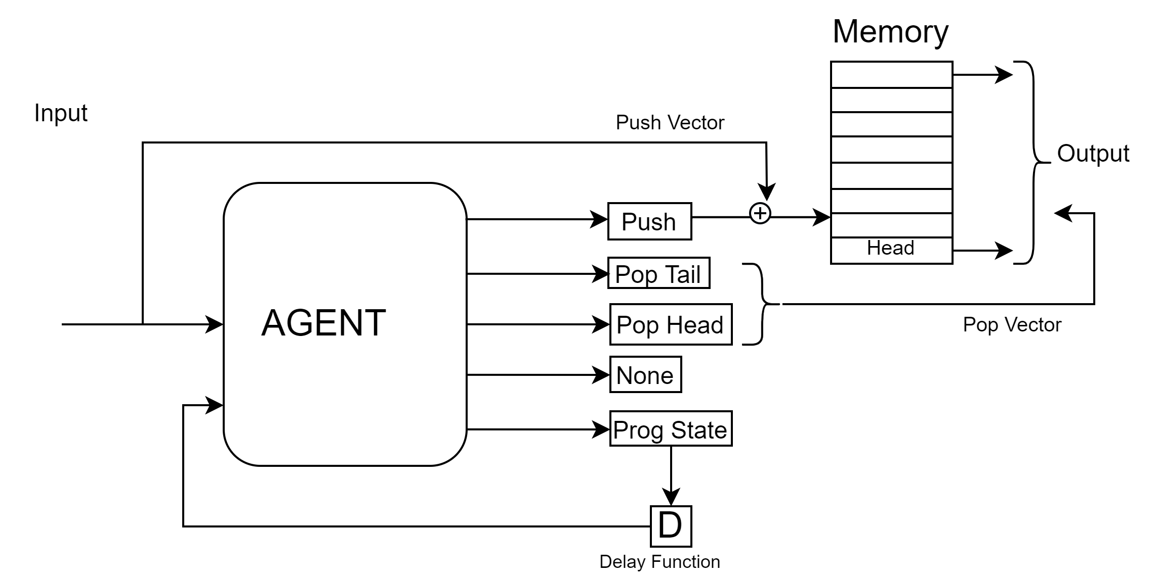
Copy Task Structure

Slide 20
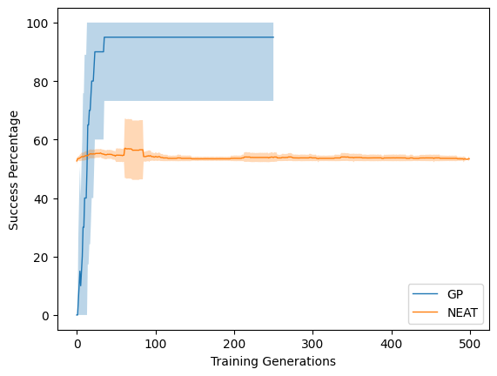
Genetic programming vs neural network

Slide 21
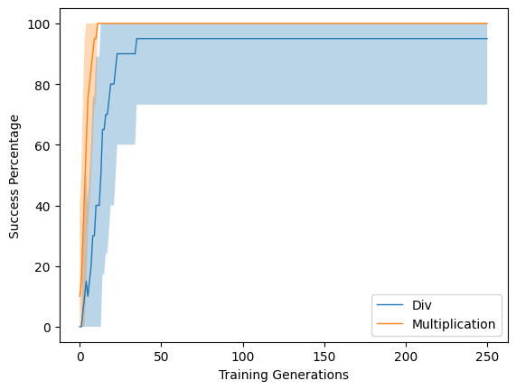
Division vs multiplication instructions

Slide 22
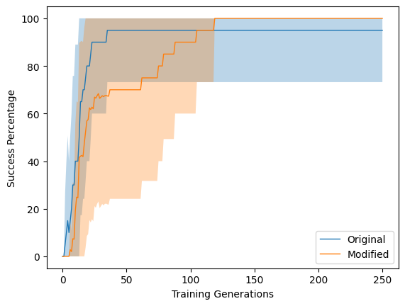
Original vs modified setup
Notes:
TODO: Add info about modified setup

Slide 23
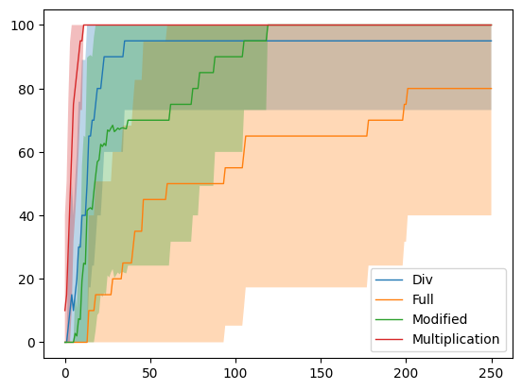
Copy Task all in one

Slide 24
What is next?
Free choices of memory
Q&A

